Slide 1
Collective Intelligence
Project Presentation
Aaron Serebrenik
yhc52f@inf.elte.hu
Gabor Eszter
nhlyn2@inf.elte.hu

Slide 2

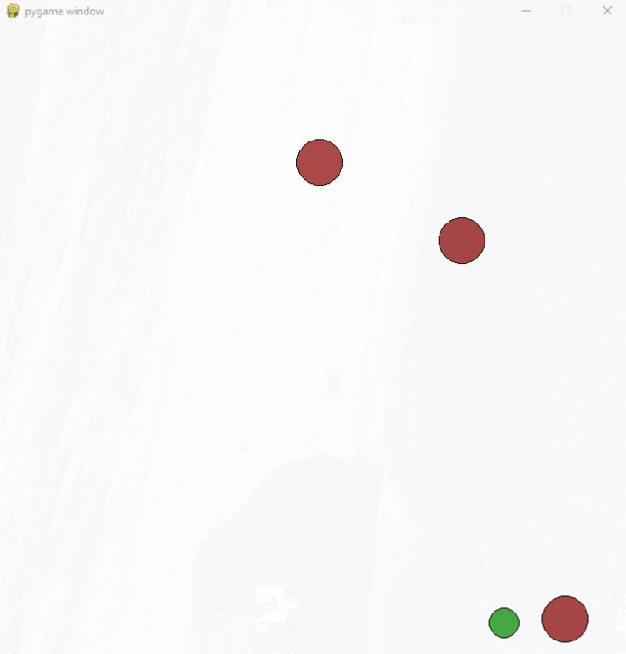
Introduction
Implementing the tag game on robots
Training neural networks to control their
behaviours In the PettingZoo environment.
Simulating Turtlebots in Gazebo, using ROS2.
Finally have robots chase one another.
Image(s)

Slide 3

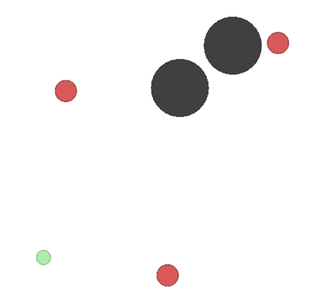
Environments I.
Training in the PettingZoo virtual environment:
N Agents, trying to flee (1 in our case)
N Adversary agents trying to catch them
Any number of obstacles + boundary
Environment rewards:
Collisions with other Agents (+for adv, -for agent)
Collisions with the wall & obstacles
Based on proximity to other agents (not toggled by default)
https://pettingzoo.farama.org/environments/mpe/simple_tag/

Slide 4

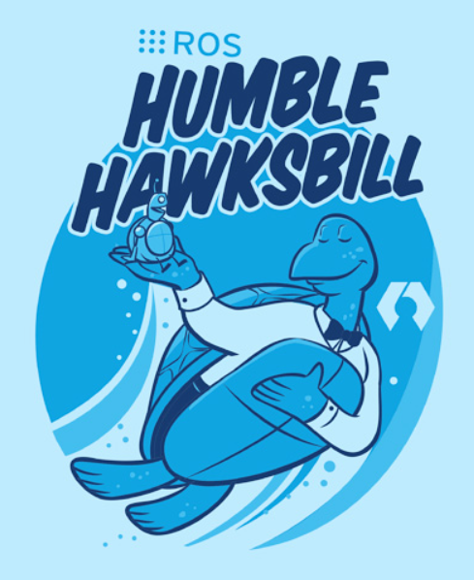
Environments II.
ROS2 Humble & Gazebo
ROS = Robot Operating System.
Covered in our Embodied int, AI & Robotics courses.
Essentially brain + nervous system for robots.
Good amount of compatibility between the two however…
When going deeper the documentation disappears.
Image(s)

Slide 5
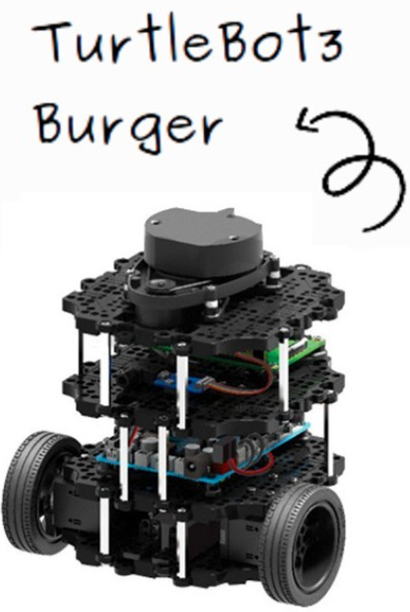
Observation & Action spaces
Observation space:
Nearly all information is available to the agents (locations, velocities)
“Good” agent observation space is always 2 dim smaller than that of adversaries in pettingzoo SimpleTag
Actions:
[no_action, move_left, move_right, move_down, move_up]
and their combinations.
Problem: Turtlebot3 isn’t capable of instant omnidirectional movement

Slide 6
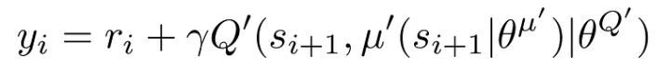
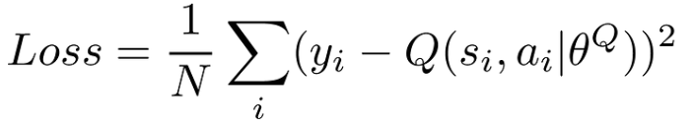
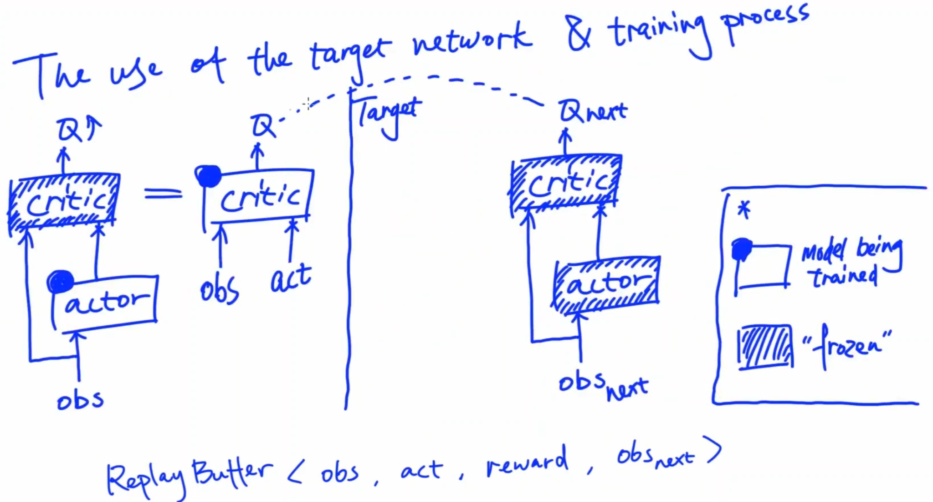
Models and Policies
Models:
Random action
MLP
Recurrent
LSTM
Policies:
PPO
DQN
MADDPG*
https://www.youtube.com/watch?v=oydExwuuUCw&ab_channel=AylwinWei
*Based on the paper: Multi-Agent Actor-Critic for Mixed Cooperative-Competitive Environments
https://arxiv.org/abs/1706.02275

Slide 7
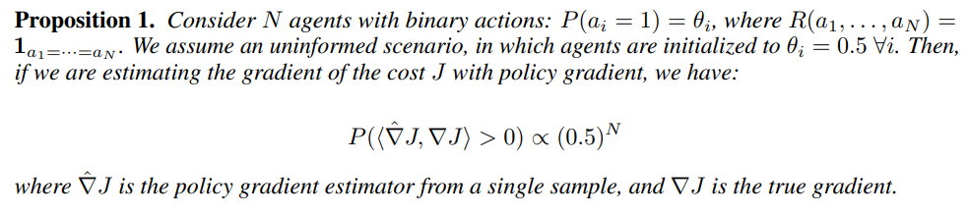
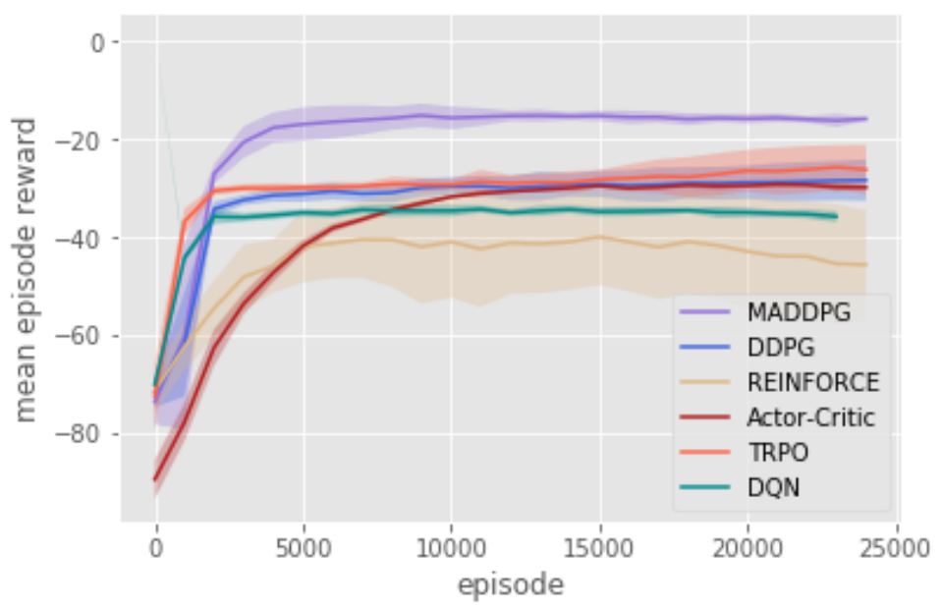
Network training difficulties
This explains why many traditional practices suffer with multiple agents.
Our situation is even more complicated, as it is mixed cooperative/competitive.
Rewards play a key role in training as one would expect.
With PPO and DQN, agents learn to catch one another, however they struggle with fleeing.
Figure 4 from the paper
In SimpleSpeaker env.

Slide 8
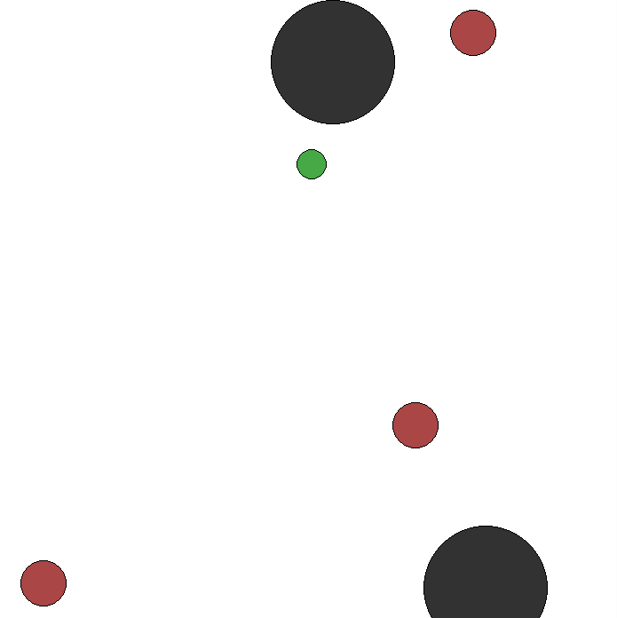
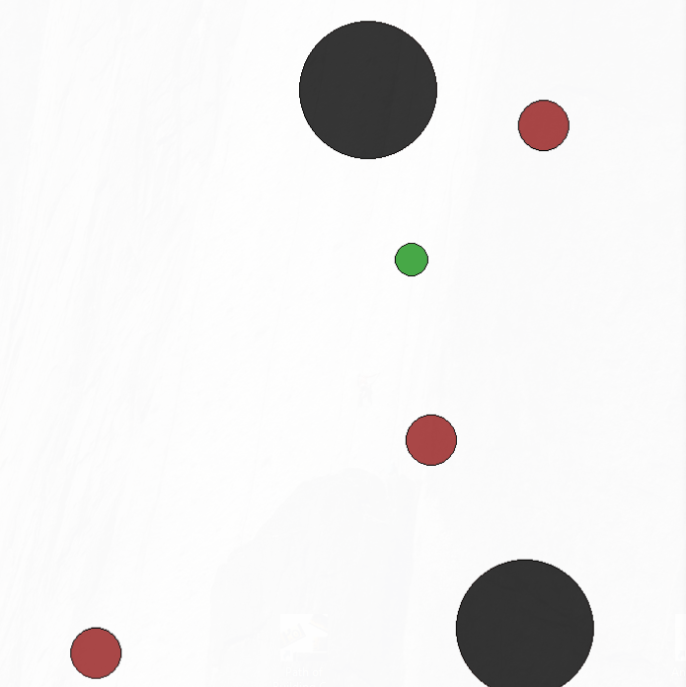
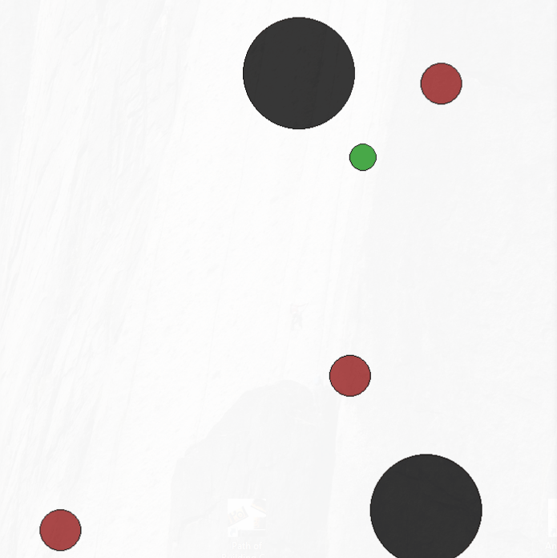
Visually comparing results
Numerically comparing results is challenging, as it is a ~zero sum game.
Training @ ~2M episodes, with ~40 frames per episode.
DQN
MADDPG
PPO
RecPPO

Slide 9
How about in Gazebo?
Transforming the observation & action space is challenging:
PettingZoo has omnidirectional movement.
VS Turtlebots have lin/ang velocity.
Realistic actions take time
Gazebo can crash or freeze
ROS & Gazebo not easy to work with & documentation often disappears

Slide 10
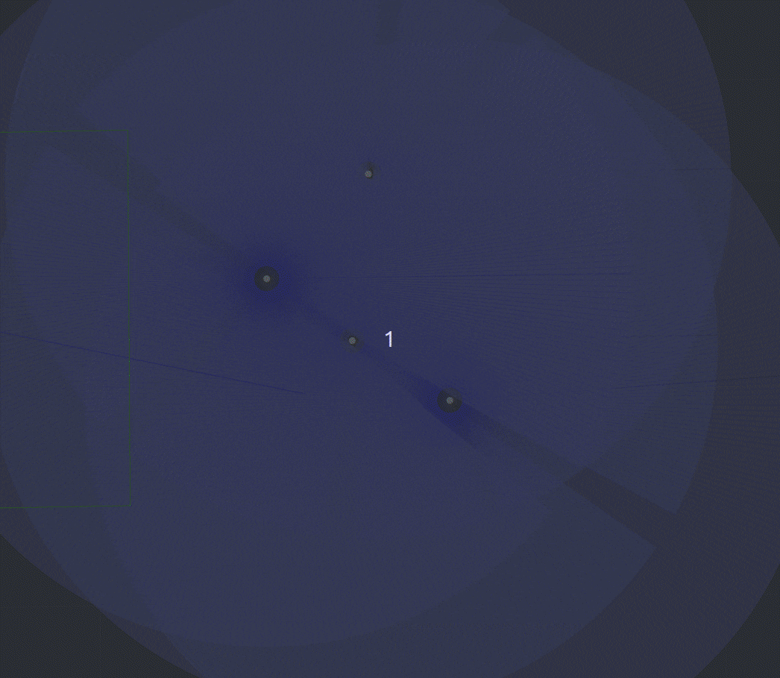
Tag game in Gazebo
First good agent on the top, three adversaries below.
Next we moved the good agent below them, and they turn to move towards the good agent.
We can see the adversaries manage to follow the good agent.
We also added an obstacle avoidance functionality, so they don’t damage each other in real life (not shown on the gif).
Equal linear velocities for all agents, as opposed to SimpleTag env
sorry for bad visual clarity

Slide 11
Conclusion and Further Work
Conclusion
MADDPG outperformed the other policies.
Other policies managed to chase the agent, but they often struggled to flee.
MADDPG took significantly longer to train than the other networks.
Although with MADDPG each adversary has its own network, one usually outperformed the rest a little (based on basic inspections in gazebo).
Further Work
Try different networks and policies.
Adapt it to turtlebots in real life (nearly finished).
Improve the real world chasing, and more dynamic obstacle avoidance.

Slide 12
Thank You for Your attention!
Questions?

